Slide 1

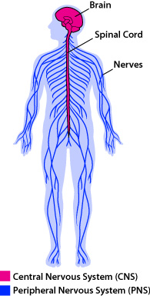
Nervous system

Slide 2
Central and Peripheral Nervous system
Central nervous system – Brain and spinal cord
Peripheral nervous system – composed of all of the sensory and motor neurons of the body and functions to gather sensory information and to control the actions of our bodies
  Sensory neurons send signals to CNS
  Motor neurons receive signals from CNS
  Reflex- an automatic reaction to a stimulus that is not consciously controlled

Slide 3

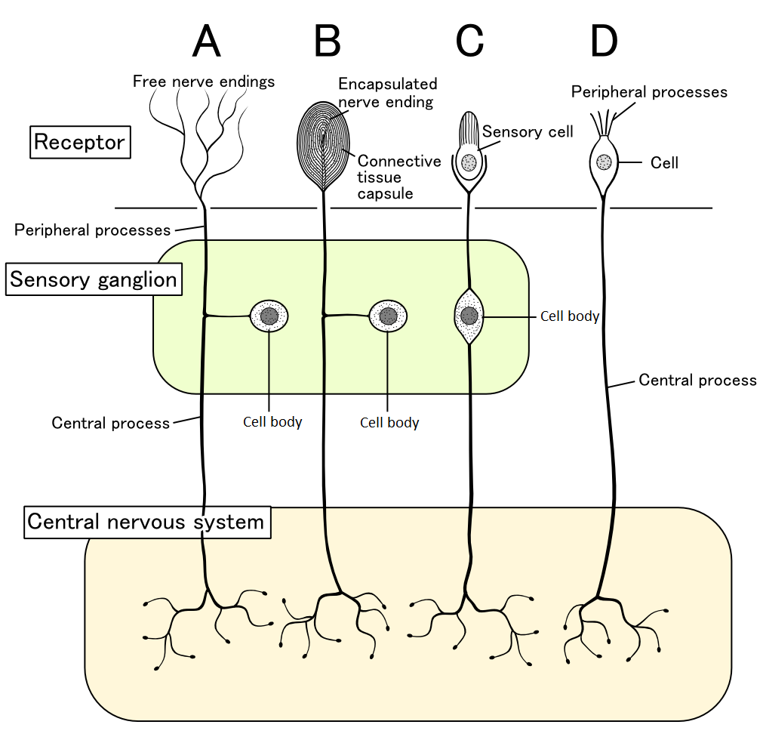
Neurons
Afferent neuron or sensory neuron picks up the stimuli
Interneuron associates the two signals to and from the brain
Efferent Neuron or Motor Neuron reacts to the message that was sent
This Photo by Unknown Author is licensed under CC BY-SA

Slide 4
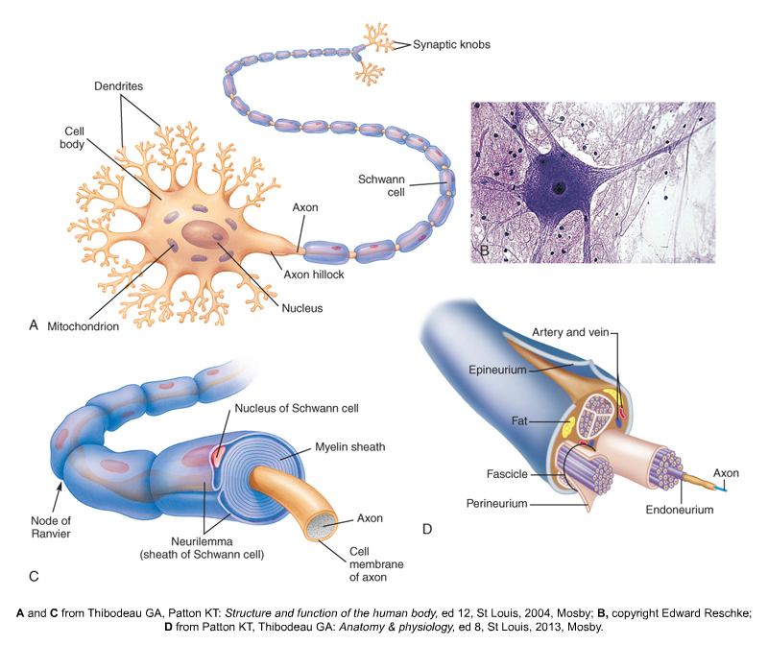
Neuronal discharge
Communication from one neuron
to another neuron is through a neurotransmitter
Dendrites- pick up impulses (receivers)
Stimuli can be excitatory or inhibitory.
Dendrites will send impulses to cell body where it will be processed.
All cells have a resting state and an excitatory state
If excited to threshold they will elicit a response.
Notes:
Dendrites (think of hands) pick up all types of signals. Dendrites then send these signals, both excitatory and inhibitory, to the cell body where it is processed. Example: lets say you get a big excitatory stimuli that raises the voltage 30 points and a minor inhibitory stimuli that brings It down 10 points. If the resting potential is -60 ( net affect is still up 20 millivolts, or -40, which is still an action potential. So the cell will discharge or fire. Conversely, if you get mostly inhibitory signals with a minor excitatory signal, the cell will not discharge or fire. Once the cell discharges it travels down the axon, starting at the axon hillock, and down the myelin sheath, from node of Ranvier, to node of Ranvier, to the axon terminal where more neurotransmitters are stored. Here it will carry a message to the next neuron.

Slide 5
Synaptic transmission
Release the transmitter
Diffusion across the cleft
Binding of the transmitter to the post synaptic receptor (affecting a change)
And finally Inactivation

Slide 6
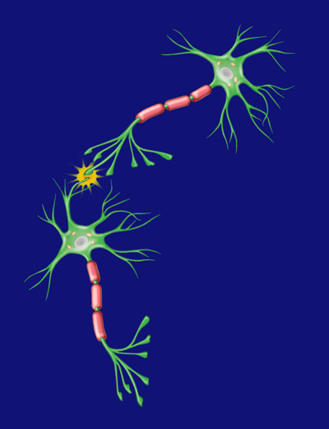
The Neuron- Animation
https://www.youtube.com/watch?v=L41TYxYUqqs

Slide 7
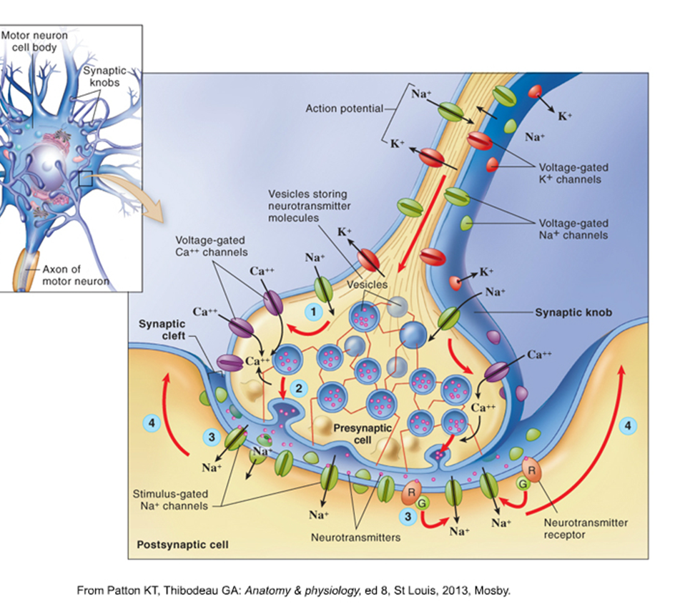
Acetylcholine
-Most common cholinergic neuron
Mostly an Excitatory response
Stored in vesicles and waits to be activated
Depolarization occurs
Neurotransmitter is released into synaptic cleft
Acetylcholine (ACh) binds to receptor
Muscle contracts

Slide 8
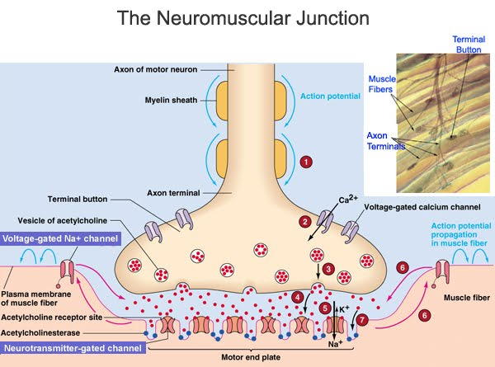
Functions of Acetylcholine
Acetylcholine performs as a transmitter at all neuromuscular (nerve-to-skeletal muscle) connections. It stimulates muscle contractions and, thus, all behavior.
Acetylcholine is the transmitter of parasympathetic half of the autonomic nervous system.
Acetylcholine is a transmitter in various brain regions (for instance, basal ganglia, cortex, and hypothalamus) and is required for proper memory and cognition, as well as motor control. The action of acetylcholine released at a synapse is ended through breakdown of ACh by enzyme acetylcholinesterase

Slide 9
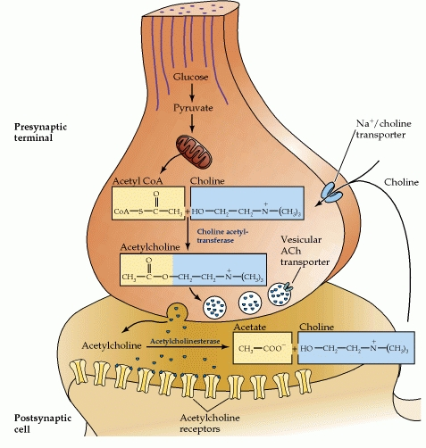
Inactivate Transmitter-
IF you did not inactivate Ach quickly, you would have spastic seizing-
1. Some transmitters are enzymatically degraded
2. Ach is broken down by Acetylcholinease
3. Then actively pumped back into the presynaptic nerve terminal away from the synapse.
https://www.ncbi.nlm.nih.gov/books/NBK11143/figure/A391/?report=objectonly
Notes:
Remember enzymes that break things down end with ASE-

Slide 10
Inhibitory Neurotransmitters
Some will say inhibition is more important than excitation
Glycine is an inhibitory neurotransmitter- released from interneurons in the spinal cord-
When Glycine binds with its post-synaptic receptor, it causes opening of Cl- selective channels- Cl- carries a NEG charge)
This action inhibits neuronal action potential
Notes:
Excitatory response is pretty self explanatory. Cell get excited, resting potential changes to action potential, then the cell is depolarized, and the action takes place. Now lets talk about the inhibitory process. This is the process that is going wrong in diseases such as Parkinson's. Glycine is not being inhibited so muscle contraction is hyperactive.

Slide 11
Common Neurotransmitters
  Acetylcholine- Primarily Excitatory ( mostly muscle)
  GABA- inhibitory ( mood)
  Glycine – primarily inhibitory ( motor / sensory)
  Glutmate-Excitatory
  Dopamine ( primarily inhibitory) ( mood)
  Norepinephrine- primarily excitatory, inhibitory in some areas of the brain ( Fight or flight)
  Serotonin - excitatory in the raphe nuclei, inhibitory in the cerebral cortex. ( mood)

Slide 12
Autonomic Nervous System
Parasympathetic Nervous system
Cholinergic
NT- primarily Ach
DAY to DAY – rest and digest
Sympathetic
Noradrenergic
NT- epinephrine- norepinephrine
Fight or Flight

Slide 13
Parasympathetic- Day to Day
Ach is primarily a Parasympathetic nervous system Neurotransmitter
Function promoted by cholinergic discharge are those associated with day to day living
Salivation
Lacrimation
Urination
Defecation
ACTIVATES the GUT
Notes:
Think of your anticholinergic medications and what they do. You get a dry mouth, dry eyes, urinary retention etc.

Slide 14
Sympathetic – Fight or flight
The Sympathetic discharge acts in emergency situations
Dilates pupils
Accelerates heart
Increase blood pressure
Constricts vessels of skin
Lowers reticular formation threshold (hyperarousal)
Elevates plasma glucose and Free Fatty Acids ( fuel)
Inactivates the GUT

