Slide 1
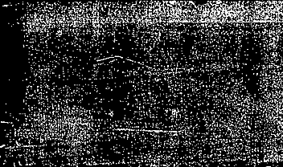

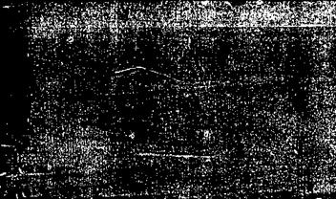
Pericarditis, endocarditis, PAD, and PVD

Slide 2
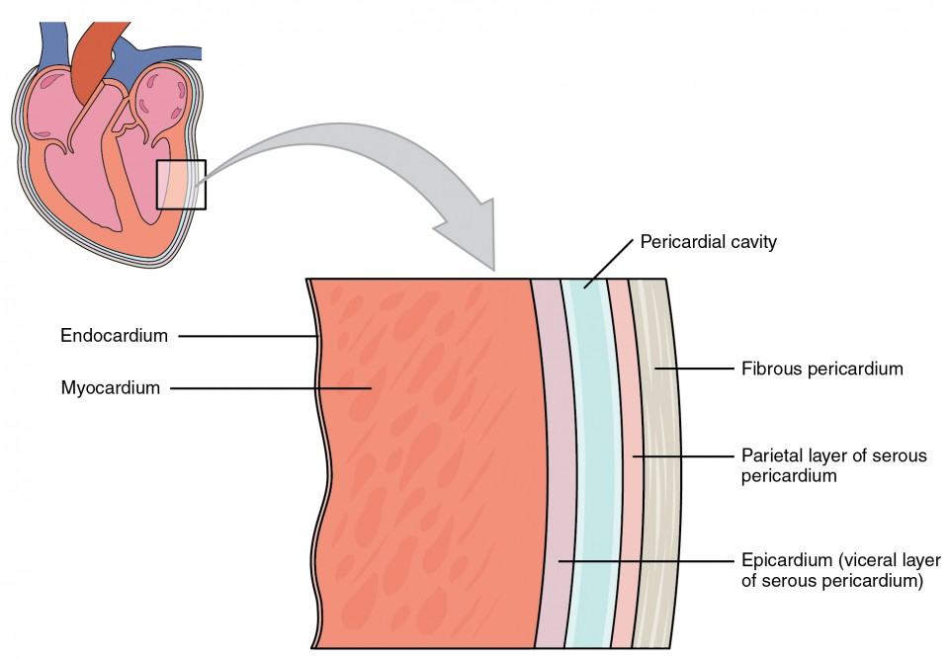
Layers of the Heart
This Photo by Unknown Author is licensed under CC BY

Slide 3


Pericardium
Pericardium encloses the heart and holds it in place
2 layers
Fibrous pericardium-
  Protects and anchors the heart
Serous pericardium
  Thin delicate membrane

Slide 4
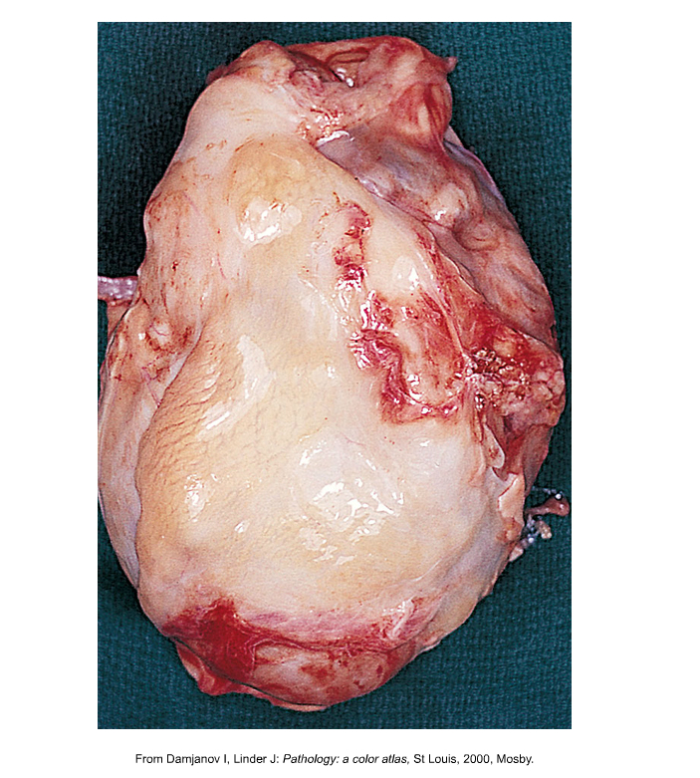
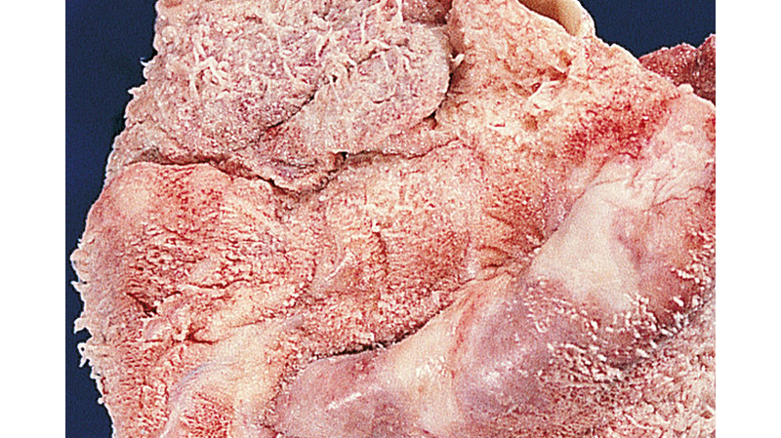
Pericarditis
This Photo by Unknown Author is licensed under CC BY
Acute
Constrictive- EMERGENCY- presents with sx of CHF

Slide 5
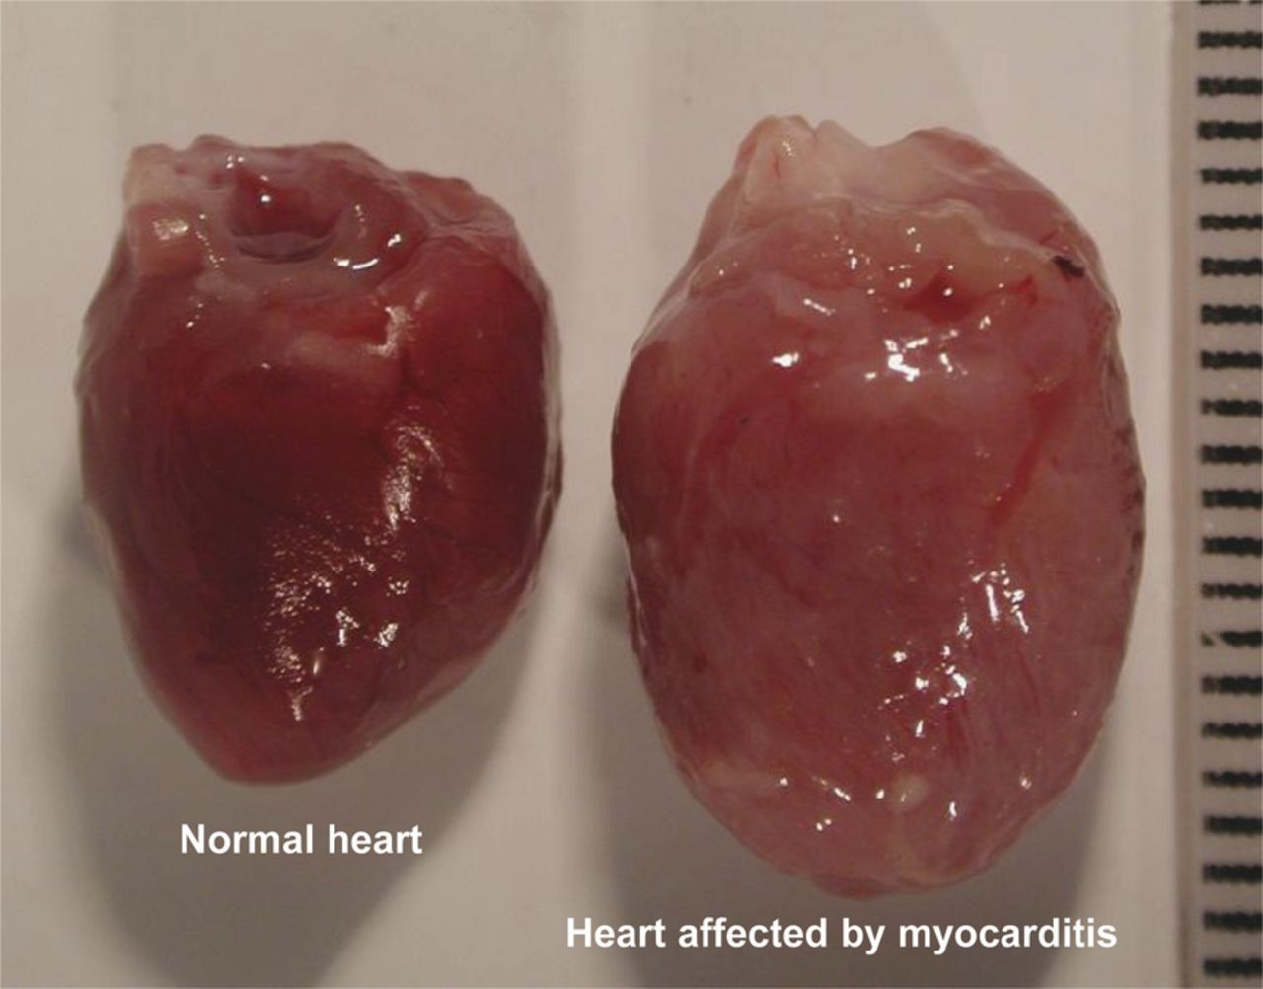
Myocarditis
This Photo by Unknown Author is licensed under CC BY
Inflamed myocardium

Slide 6
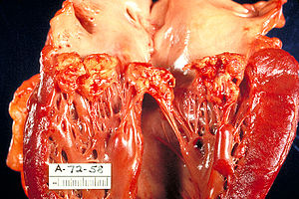
Infective Endocarditis

Slide 7
Case Scenario
CC- back pain
HPI-58 yo female just got back from Florida c/o having high fever up to 105 a couple of days with chills. Now she is better, she does not know what happened. She also noticed while at Disney she had some SOB and was not able to walk as far, but now she is having excruciating pain in her lower back radiating down one leg.
PE- pt is morbidly obese with bilateral lymphedema that is chronic- lungs sounds are clear, lower back is tender, SLR are neg, temp is normal
What tests do you want?
Notes:
CBC was normal
Echo was normal
Back xray was normal.
MRI of back revealed
Blood cultures were positive for viridans Staphylococci

Slide 8
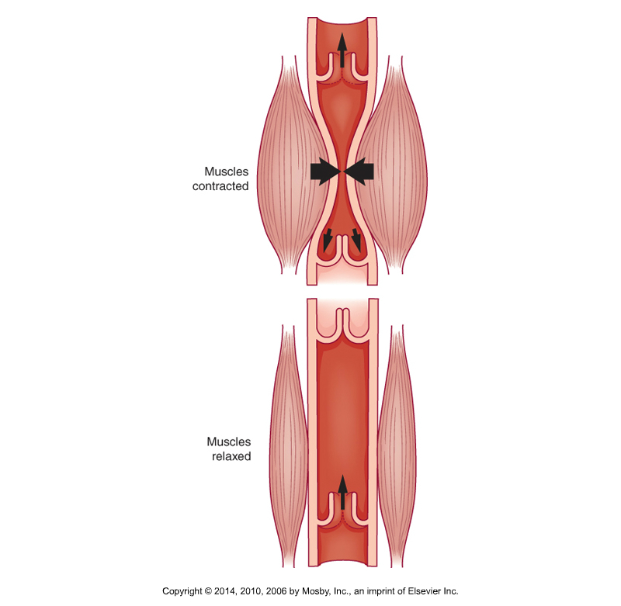
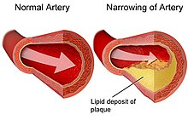
PAD verses PVD
Chronic edema
Worsening edema as the days goes on
Improved with elevation
Pain with walking
Decreased pulses
Cold leg

