Slide 1

Obesity, Metabolic Syndrome and Malnutrition

Slide 2
Obesity
Obesity is classified as a disease
Considered a global epidemic
We need to screen for it
We need to treat it BMI
●Overweight – ≥25.0 to 29.9 kg/m²
●Obesity – ≥30 kg/m²
•Class I – 30.0 to 34.9 kg/m²
•Class II – 35.0 to 39.9 kg/m²
•Class III – ≥40 kg/m² (also referred to as severe, extreme, or massive obesity)
Notes:
Measles, TB, Zika, Ebola

Slide 3
Waist circumference-
Greater than 40 in Men
and Greater than 35 in woman is indicative of increased cardiometabolic risk

Slide 4
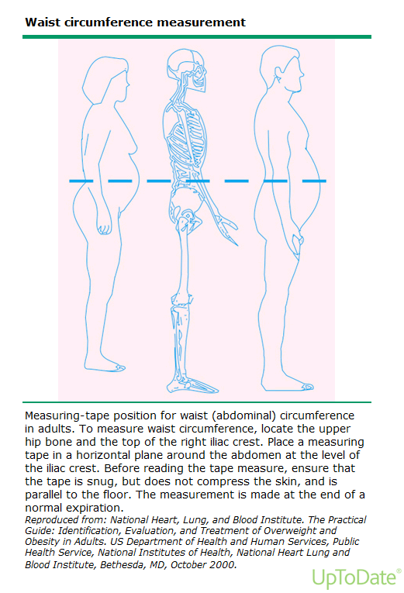
Waist Measurement
MEN > 40
WOMEN > 35

Slide 5
Pathophysiology
Genetic component – twin studies show 60-90%
FTO gene on chromosome 16 has strongest genetic association with obesity
A variant in this gene predisposes to type 2 DM
Diseases – causing change to the metabolic rate
Environmental factors – obesogenic environment

Slide 6
Its not just calories in – calories used
Regulation of Body weight- Feedback control system
Resistance to weight loss
Gut microbiome
Determinants of energy expenditure
Gut hormones –Ghrelin
Inhibitors of food intake – GLP1

Slide 7
Metabolic Syndrome
National Cholesterol Education Program ATP III
ATP III criteria define metabolic syndrome as the presence of any three of the following five traits:
●Abdominal obesity, defined as a waist circumference ≥102 cm (40 in) in men and ≥88 cm (35 in) in women
●Serum triglycerides ≥150 mg/dL (1.7 mmol/L) or drug treatment for elevated triglycerides
●Serum high-density lipoprotein (HDL) cholesterol <40 mg/dL (1 mmol/L) in men and <50 mg/dL (1.3 mmol/L) in women or drug treatment for low HDL cholesterol
●Blood pressure ≥130/85 mmHg or drug treatment for elevated blood pressure
●Fasting plasma glucose (FPG) ≥100 mg/dL (5.6 mmol/L) or drug treatment for elevated blood glucose

Slide 8
Malnutrition
Can be from diseases such as Celiac and Crohn's disease
Can be from behavioral issues such as binging or anorexia
Can be from aging and poor nutritional intake.
Monitor fat-soluble vitamin
  A, D, E, and K

Slide 9
Geriatric
Malnourished defined as loss of more than 5 -10 percent of an older person's usual weight in one year.
  Usually related to one of four conditions or a combinations
    Inadequate dietary intake
    Appetite Loss
    Muscle Atrophy
    Inflammatory effects of disease ( cachexia)

